Slide 1
Digital Marketing Optimization
Randy Lea, Vice President, Aster Data Center of Innovation
Teradata
September 2011

Slide 2
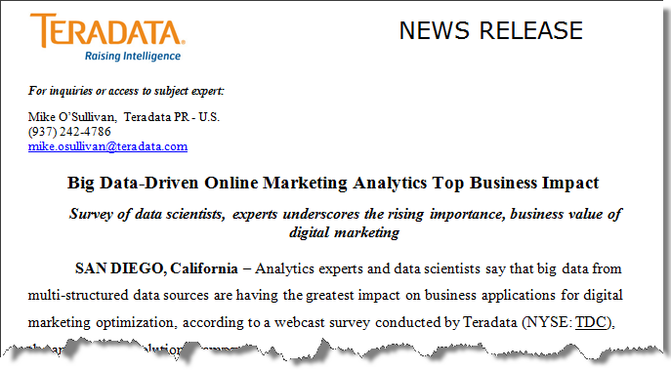
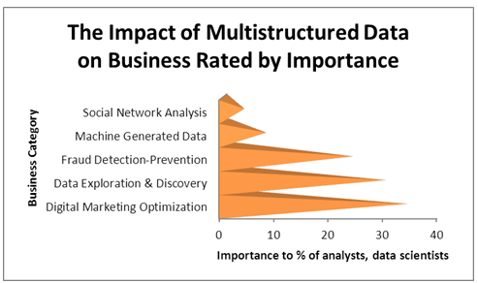
Some Interesting Trends in Big Data Analytics
Survey results announced Monday, September 18
Source:
Teradata-Aster Data Survey Conducted July 2011

Slide 3

Disruptive Change Today In Marketing
Respond with the science of data and the art of marketing
Proliferation of new digital channels continues
  E-mail, organic search, paid search, display advertising, video advertising, Twitter, Facebook…
Increasingly critical to integrate cross-channel customer insights
  Digital advertising triggers $6 in off-line spend for every $1 online
Complexity of marketing mix demands data-driven decisions
  Bringing the science of data to the art of marketing

Slide 4






Those That Tap Into the Disruption With the Right Tools Will Have Competitive Advantage
Social Networking & Relationship Analysis | Advanced Clickstream & Attribution Analysis | Advertising & Media Analysis
Social networking graph analysis Crowd-sourcing Virality analysis Content targeting | Online consumer behavior/patterns Advanced click-stream analysis Online targeting for personalization/ recommendations | Digital media consumer micro-targeting Organic & paid search optimization Advertising impression, saturation & conversion analysis
Need for deep data analysis…on TB’s to PB’s of data…
with minutes to seconds response times
“Analytics themselves don't constitute a strategy, but using them to optimize a distinctive business capability certainly constitutes a strategy.”
- T. Davenport & J. Harris, Competing on Analytics: The New Science of Winning

Slide 5
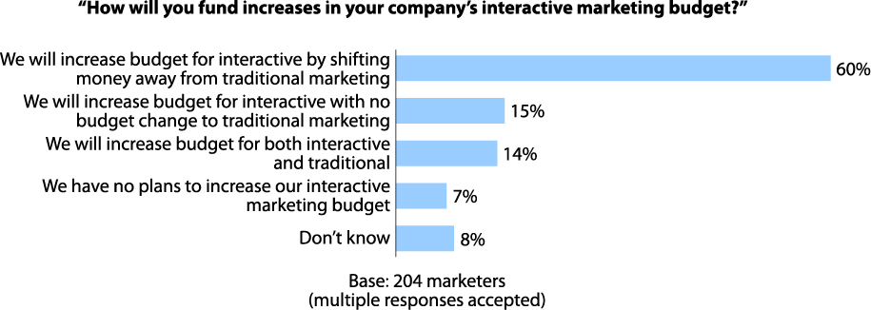

Interactive Marketing Budgeting for Big Data
Interactive marketing budgets to top $55B by 2014
Source:
Forrester, US Interactive Marketing Forecast, 2009-2014

Slide 6
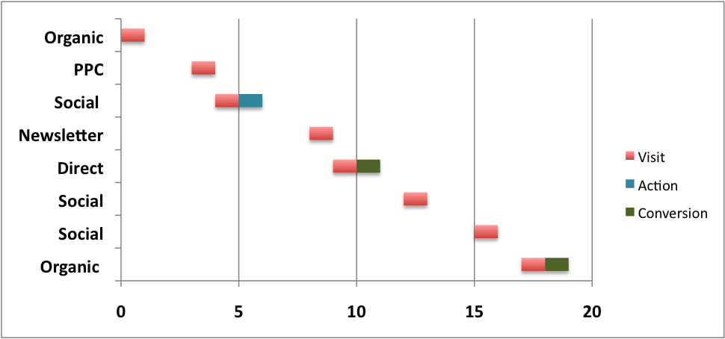
The Marketer’s Big Data Challenge:
Knowing the Most Productive Marketing Mix
Customer Interaction Map: Retail
Signed Up for the Newsletter
Referring Channel
Bought Things
Weeks

Slide 7
No Matter What the Industry or Media
Single Customer Interaction Map: Banking Website
Homepage
Log-In
Mortgage
Mort_Article
Website Pages
Mortgage_Ad
Rate_Compare
Estimator
Agent_Mtng
# of Pages/ Page Depth

Slide 8
Particularly When Multiple Campaigns Are Involved in Conversion
E-mail Direct Marketing
  Send, open, click & conversion events
On-line Interactions
  Organic search optimization
  Paid search
  Display & video advertising
  Social media: Twitter, Facebook…
Inbound Marketing Channels
  IVR interactions
  Customer service center interactions
  Website interactions

Slide 9
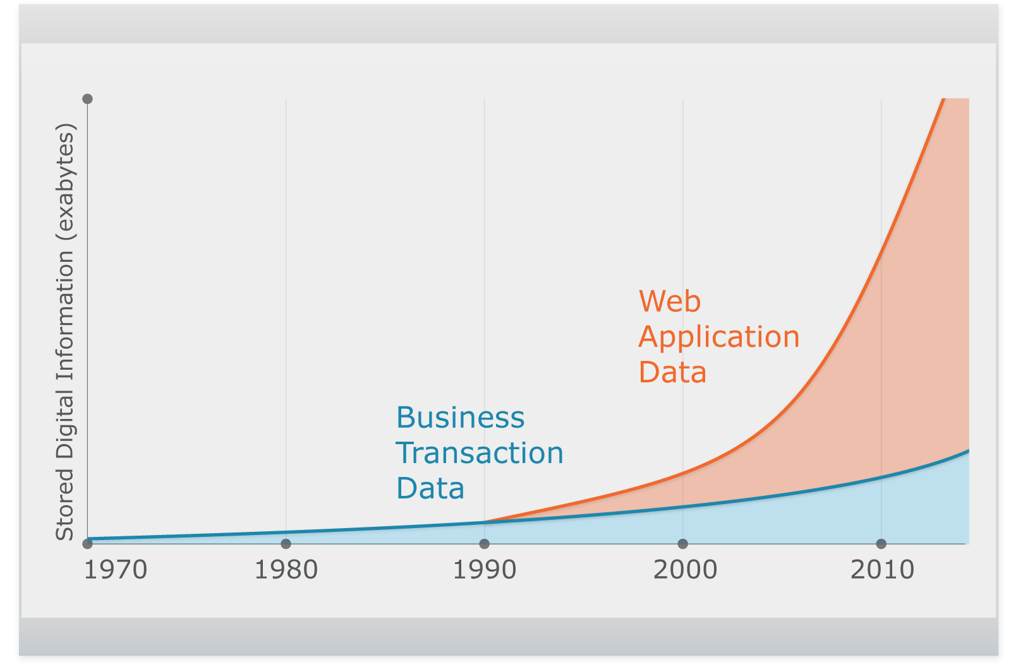

Good News is that Digital Channels Provide a Wealth of Data
  Digital content is the primary driver of new data through 2012
  80% of this new data is digital data that is complex to analyze in its native structure
  Digital data is growing at 62% annually vs. structured data at 22%
Complex,
Unstructured
Relational
Source: An IDC White Paper. As the Economy Contracts, the Digital Universe Expands. May 2009.

Slide 10
But In Its Raw Format Digital Channel Data Is Not Structured for Easy Analysis
Multi-structured formats
  Raw click streams
  Long descriptive text
Inconsistent grain across channels
  Some detailed
  Some aggregated
Stove-piped by channel
Existing single channel analysis
  Email conversion rates
  Call handle times
  Last click attribution
Raw Apache Weblog

Slide 11
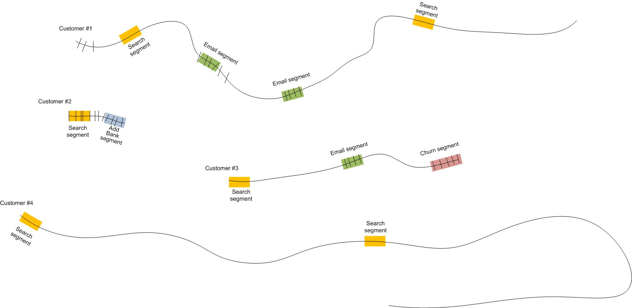
Particularly When It Needs to Accommodate Customer Interactions
Provide a standardized structure for analyzing within and across multiple customers
Patterns of interactions can be explored and then modeled
11 >

Slide 12
To Deliver Business Benefit
Defined interactions
… in a time series
… integrated across all channels
… tied to a customer and transaction
And for Marketing
… attributed to a campaign

Slide 13
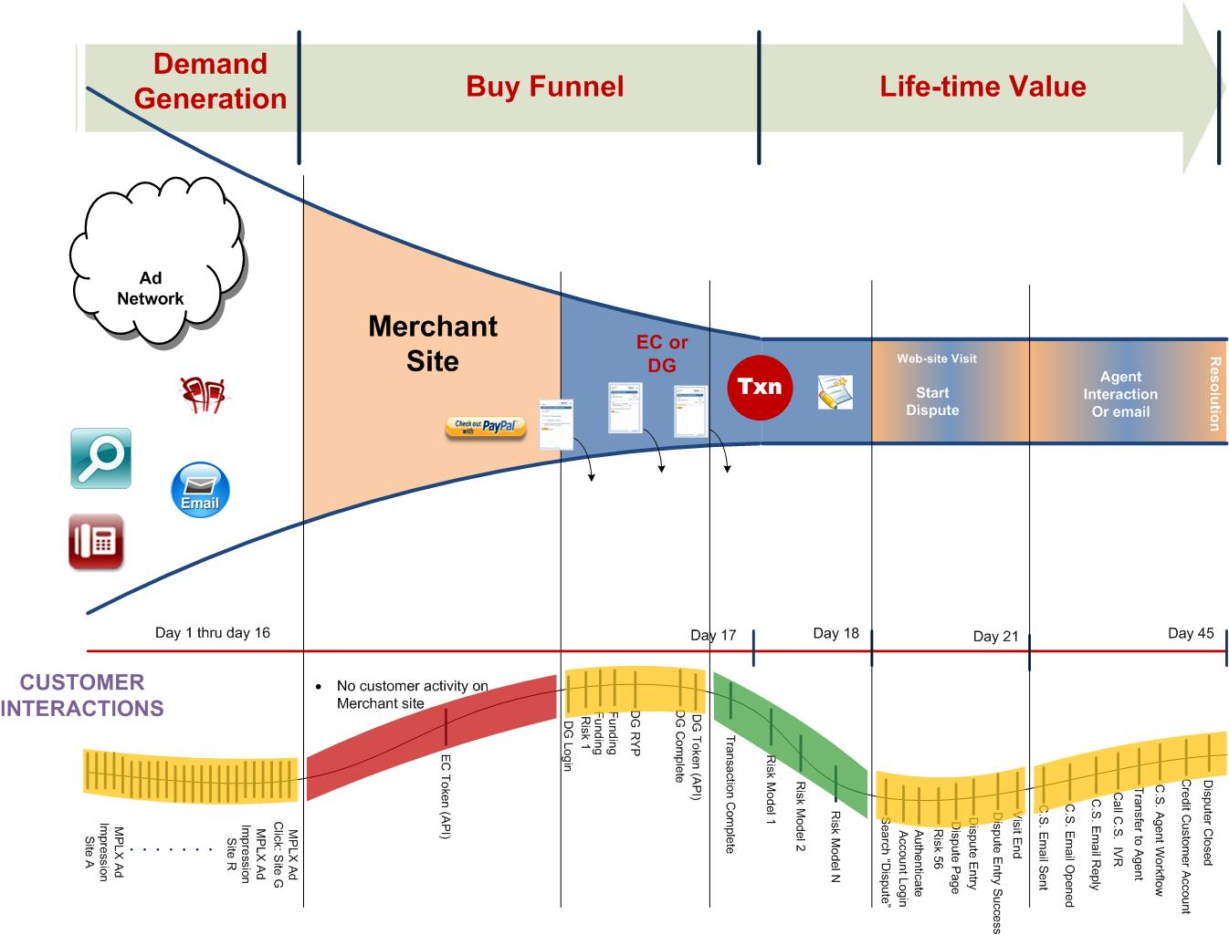

And Ultimately Marketing Optimization
< 10% Convert

Slide 14
How Big Data Analytic Platforms Do It
Analysts
Customers
Business Users
Data Scientists
Your Analytics & Advanced Reporting Applications
Big Data Analytic Platform
Analytics Development
Pre-packaged modules
Development tools
Programming frameworks
Develop
Analytic Processing
Standard SQL
No-SQL techniques; MapReduce
Multiple programming languages
Process
Parallel Data Storage
Relational and Non-relational
Relational: Row and column
Non-relational: Distributed file systems like Hadoop
Store

Slide 15
Step 1: Parallel Data Storage
Dynamically interpret raw web log data via MapReduce
Massively Parallel Processing Analytic Platform
SQL-MapReduce Staging for nPath
Analytics output in structured form for further analysis or distribution to the EDW
Timestamp | Referral | Customer | Session
MapReduce
program runs in-platform
Raw Log Input
Raw Log Input
High-speed, parallel loading
Clickstream_Log
Clickstream_Log
Click-stream Log Data
Raw Apache weblogs

Slide 16
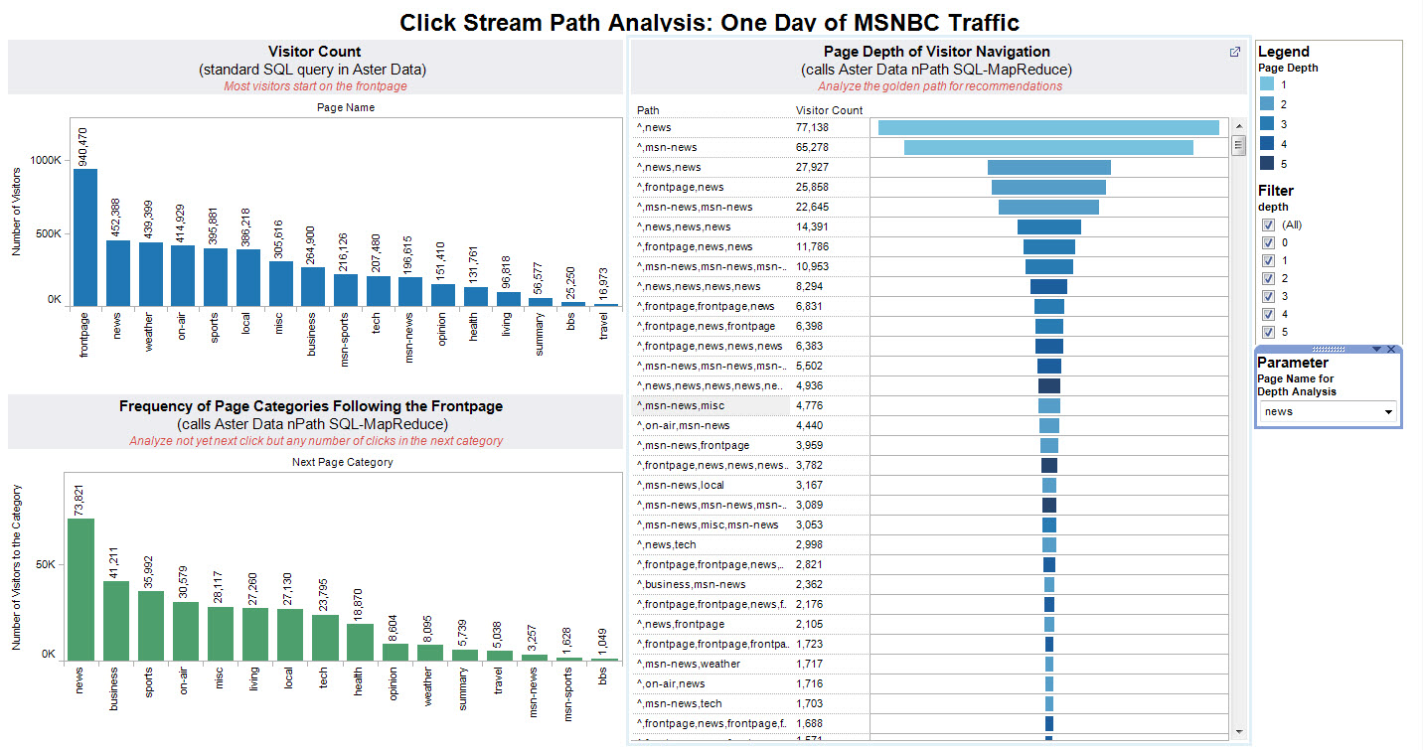
Step 2: Big Data Analytics Processing
Behavioral Analysis
“Find Me All Behavioral Patterns that Led to Purchase”
MapReduce analytics for cross-row pattern matching at the highest levels of performance
Reusable analytic logic appropriate for path & pattern matching on any input
Patterns are Flexible & User-Defined

Slide 17
Step 3: Big Data Analytics Also Attribute Conversions to Marketing Campaigns
Week 1
Week 2
Week 3
Week 4
C
Frequency
Daypart
Visits
Conversion
Attribution
Recency
Order
+
Flows
=
+
Ad Size
Targeted
Social
Rich Media
Multi-channel
Video
Weight Influence of Each Campaign Touch on a Customer Conversion

Slide 18





Optional Step 4: Move From Insights to Marketing Optimization
CookieID | UserID | Attribution_Path
Marketing Applications
Campaign Mgmt.
MRM
Other
Apps
Big Data Analytic Platform
Integrated Data Warehouse
Analytics Development
Structured Insights
(examples)
Campaign/Media Costs
Marketing ROI Calculation
Customer Value
Analytic Processing
Parallel Data Storage
Raw Web Logs
Social Media APIs
3rd Party Data
OLAP
SQL Analytics
Reporting
ERP
E-POS
Legacy
Consumer

Slide 19
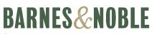






Teradata Aster MapReduce Platform
Aster Data is the leading innovator in the ‘big data’ analytics market
Aster Solution: MPP Analytic Platform that delivers a MapReduce analytic framework within a database platform
For the Data Scientist: Brings the science of ‘big data’ to the masses with MapReduce functionality delivered through the analytic language of business, standard SQL
Delivers New Analytics: Provides businesses with new, breakthrough analytic applications with high-performance and pre-packaged pattern, path and graph SQL-MapReduce analytic modules
On Multi-structured Data: Leverages multi-structured data sources for increased analytic breadth & accuracy
A Teradata product line as of March 2011
Customers

Slide 20
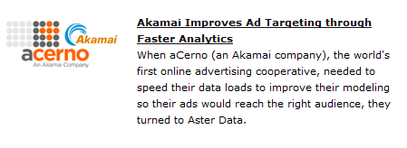
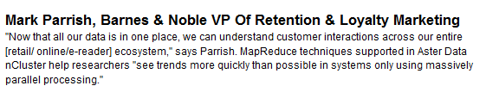
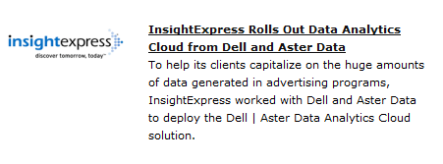
Read More About Big Data Analytics Success
http://www.asterdata.com/customers/customer-casestudies.php
Aster Data Customers Using Digital Marketing Optimization
  Example Customer Results on Aster Data
  Data loads every 5 minutes to provide clients with a near real-time interactive analysis environment
  Query response from 45 minutes to less than 7 seconds.
  A complete scan of the database used to take 30 hours but now takes under 60 seconds.

Slide 22
Value of Teradata Solutions for Digital Marketing
Aster Data Big Data Analytics
Click-stream
  # of visitors, visitor location, browser type
  Last click analysis
Online behavior
  Common interaction behaviors
  Optimal paths through website
A/B testing
  Where to place this button, link, etc.
Search Optimization
  Mix of paid per click and organic
  Which search terms drive traffic, behaviors
Advertising Optimization
Conversion
  How to optimize advertising placement
  Where are shopping carts abandoned & why
Marketing Attribution
  What % credit to give each referring channel or campaign
+ Teradata Integrated Data Warehouse Adds…
Marketing return on investment
  Attribution + cost of conversion
+ Aprimo Adds…
Campaign management
  Take action to influence behaviors
Marketing Resource Management
  Take action to optimize marketing spend

Slide 23


Today’s Marketing Challenges
Channel Mgrs
Analysts
Key Business Questions
What are the Most Profitable Online behaviors? How Do I Encourage conversion?
Which keywords drive more profitable conversion?
How can I rapidly capitalize on Multivariate Testing results?
How do I leverage Marketing Attribution to Optimize Marketing Spend
E-Comm
CMO
Notes:
23

Slide 24
Online Marketing Attribution
Last click just isn't good enough any more: more complex attribution models are required.
What is the true lift on my external display Ad spend?
  How many impressions does it take to get a conversion?
  How do my other marketing programs (email, search, etc.) overlap display Ads?
Online channel integration
  isolate lift across search, email, display Ads
  Develop better media mix models

Slide 25
4 Aspects of Attribution
Successful Conversion
  last click
Level of interaction
  Depth of flow
Every message seen
After the fact
  Value of customer after the transaction

Slide 26
Attribution Approaches
Last Click
Simple attribution
  Order
  Latency between Ads
Less simple
  Identify the attributes of each Ad (rich media, size, etc.) and determine which attributes of an Ad appear to be more influential
A bit more complex
  Add in the number of clicks the Ad had (e.g., we want to know that an Ad that had a much higher click-thru rate (overall) might have a bigger influence on the specific conversion
Even more complex
  Depth of flow
  Duration of session
  Number of visits before conversion
  User visited more valuable pages (e.g., larger percentage of time in the “right flow” in that session.
Add in audience-based
  How about if the Ad seen fit the target segment the Ad was meant for?
And then social
  Sharing, liking, influencing, etc.

Slide 27
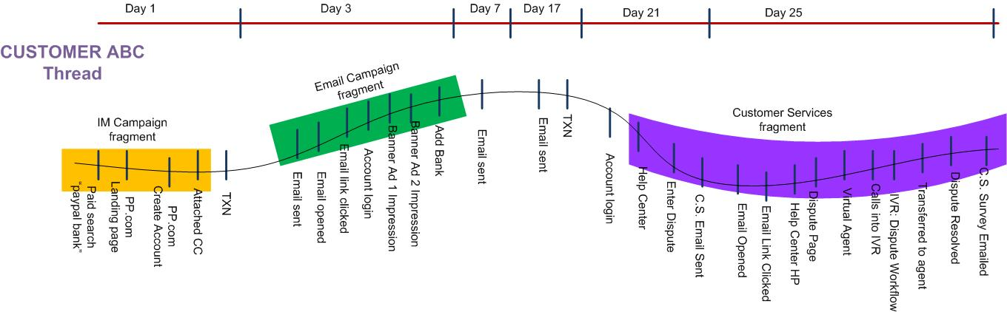
Customer Thread

Slide 28
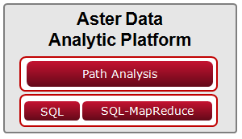
Value of Aster Data for Digital Marketing
Aster Data Analysis
Click-stream
  # of visitors, visitor location, browser type
  Last click analysis
Online behavior
  Common interaction behaviors
  Optimal paths through website
A/B testing
  Where to place this button, link, etc.
Search Optimization
  Mix of paid per click and organic
  Which search terms drive traffic, behaviors
Advertising Optimization
Conversion
  How to optimize advertising placement
  Where are shopping carts abandoned & why
Marketing Attribution
  What % credit to give each referring channel or campaign
Raw Web Logs
Social Media APIs
3rd Party Data

